Slide 1
Creative Ways to Fund Your Schwartz Center Membership
May 31, 2018
Notes:
SAY introduces

Slide 2
Audience Reminders
You may submit a question by typing it into the “Question and Answer” pane at the right of your screen at any time.
We value your feedback. Please complete our electronic survey following this webinar.

Slide 3
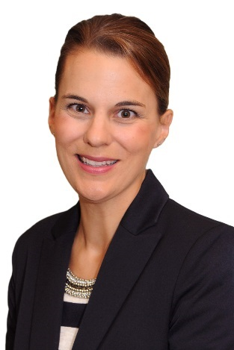
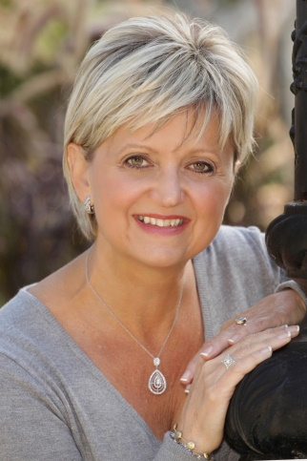
Featuring:
Lisa M. Crane
Director of Individual and
Foundation Giving
The Schwartz Center for
Compassionate Healthcare
and
Louisa Nedkov
Manager,
Kailo Employee Wellness Program
Oakville Trafalgar Memorial Hospital
Halton Healthcare

Slide 4
Topics
Seeing the opportunity, not the burden
Building a relationship with fundraising, marketing and public affairs colleagues
Thinking about possible donors
Thanking donors
Discussing costs of membership
Case Study: Halton Healthcare
Notes:
Review topics
F/r can be scary – let’s look at the opportunity, not the burden
Great way to work together with colleagues you may not normally
How to strategize w/ f/r colleagues on possible donors
Thank donors who have underwritten SC membership for their organization
Discuss how to put together a comprehensive budget to present to donors
We’ll share some case studies on what has worked in other institutions

Slide 5
1. Seeing the opportunity, not the burden
Notes:
Let’s come back to the first topic
Imperative to remember that in any institution, teamwork is paramount
You all understand that b/c healthcare is delivered through care teams increasingly these days
SC membership is a tremendous opportunity for your f/r colleagues

Slide 6
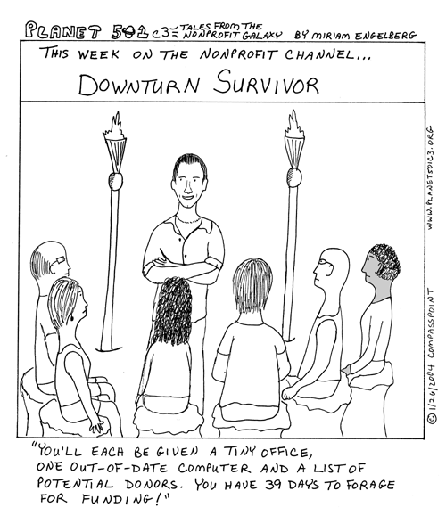
You have an opportunity for your fundraising team
SC membership is an opportunity for your colleagues
Fundraisers need special projects to raise funds
They need a “hook”
SC membership is a very compelling hook
Notes:
Fundraisers are always seeking very specific projects to raise money for
Some donors give unrestricted funds, but more often than not, they are looking for specific needs that they can get their head around and their heart around
SC membership is actually an opportunity to help f/r colleagues raise more money
It’s a very compelling hook – many donors understand what you understand, that it makes sense for caregivers in an institution to have a shared, sacred space to receive support from one another and to get reenergized from one another
And, that as a potential patient at your institution, they will be better served by caregivers who receive emotional and psychosocial support from their institutions through programs like SC Rounds and our other programs.
So, let’s talk about how opportunities and ideas can translate into donations – this is my realm, but not necessarily yours.

Slide 7
Opportunities and ideas translate to donations
Your idea around SC membership can raise more money for your organization
You can offer an invaluable tool for the fundraising professionals at your institution
They should be thrilled to hear from you!
Notes:
Your idea around SC membership can raise more money for your organization
You have an opportunity to offer an invaluable tool to your colleagues that they are going to be excited about, and excited to hear from you

Slide 8
2. Building a relationship with your fundraisers
You each have a piece to the puzzle and can help each other out
Identify the right fundraiser
Do you already have an existing relationship?
Start with the Director of Development
If they are not responsive, reach out to a Major Gifts Officer
Educate fundraising team on what the program is about, or share what is inspiring you to want to become a member of the SC
IDEA: Include fundraising team on distribution list for Schwartz Rounds sessions
IDEA: Get them to attend a session—they will be sold!
Notes:
So this gets us to the next question – how do you go about building a relationship with your fundraisers? Keep in mind that you each have a piece of the puzzle and you can help each other out.
Your piece – a really valuable program
Their piece – they know how to fundraise
One of the first things you need to think about is to identify the right fundraiser in your institution to talk to
Maybe you already have a relationship with someone
If you don’t, start w/the director of development – depending on size of org, may go by other titles: VP of Advancement; Chief Development Officer
If you find that they are hard to reach – often out in the field meeting with donors and not at their desk as much – reach out to a major gifts officer or title like that. That is someone who is particularly responsible for reaching out to individual donors at larger gift levels; often $5k or $10k and above. For very large academic medical institutions, they may work exclusively with donors who give $100k and above. But any event, both MGOs and CDOs are responsible for building relationships with donors and thinking about special projects that will engage them in the institution’s mission
Then your task is to educate that person on what the SC and Rounds is – how it has (or could) make a different to you as an indiv. and to the institution. Channel the emotional connection you have to inspire the fundraiser – why you are passionate about the SC, why you are choosing to devote your time to it
Some ideas: 1) Include fundraisers on the Rounds email distribution list; 2) actually invite them to a session – assure the participants that everyone maintains confidentiality, including non-clinicians. I’ve attended many Rounds and brought guests, and never had a problem as long as I requested a visit in advance.
If you are a prospective SC member and don’t yet run the Rounds, contact myself or Stephanie and we can find a Rounds program near you for you and your fundraising colleague to observe
Confident that your f/r colleague will be wowed by the program and sold on its value

Slide 9
3. Thinking about grateful patients or clinicians
Mrs. Smith once made me promise that if there was anything she could do to help that I should ask her.
One of the hospital trustees shows up to Schwartz Rounds every month. Many times I see tears in her eyes. Maybe she could help us think about possible donors.
Dr. Rosen was always passionate about patient-centered care—I heard his family is looking for a way to memorialize or honor his involvement at the hospital.
Notes:
So once you’ve built that relationship, let’s think about the third topic – possible donors for this cause
Of course your job is not to own those relationships, but anyone involved with the Rounds has some interaction with grateful patients or clinicians
Here are three different examples you can discuss w/ your f/r colleague
Mrs. Smith… as a clinician, these types of conversations come back to you. Share this w/your f/r colleague now
Trustees…for current members, this can be a common occurrence. Trustees become so inspired by the program – maybe he/she can help.
Dr. Rosen… You may think that as a clinician, you give your heart and soul and your first thought isn’t to give financially as well. But there are actually clinicians who support their institutions financially, and there also are other patients, family members, and friends who may be looking for special ways to honor that clinician.
We have people in our area who give to the SC in honor of a clinician, because they are so impressed by the care they received
Doesn’t have to be someone who is involved w/the hospital currently – maybe someone who was very involved but has passed away. We’ll be presenting an example of this type of situation towards the end of this webinar.

Slide 10
Thinking about institutional donors
Many of us buy our lunches at the deli across the street; maybe they would consider donating pasta salad and sandwiches for the lunches.
Companies interested in quality and safety initiatives are often interested when they learn about the Schwartz Rounds.
Our food service might be interested in making a donation of the food for each session…
Notes:
You and your f/r colleague can also think about institutions that might be able to help.
As an example, the food service in your institution might be interested in making a donation towards the food for your sessions – breakfast or lunch.
Talk to your f/r colleague about inspiring them to consider donating the drinks, salads, or sandwiches
There are companies interested in quality and safety – if you can describe how the SC impacts patient quality and safety, your f/r colleague can use that for an approach. It may not be something you think about very often, but it may just be the hook necessary for a business to consider undwriting the SC membership.
We here at the SC main office have materials that can help your fundraisers make the case about how employee experience is impacted by SC Rounds program, and how employee experience then drives patient experience. Please ask for them.

Slide 11
4. Thanking donors
We have an international reputation and a strong “brand” –
Schwartz Rounds®
~
Donors like knowing they are affiliated with
a well regarded national program
~
There are many creative ways to thank or
memorialize a donor….
Wording at the bottom of promotional materials
Tent card on the tables at each session
Announcement/slide at the beginning of each session
Notes:
Let’s switch from discussing how to raise money and from whom, to the end of the process and thanking donors who do step up.
The Rounds session offer an opportunity to thank the donors
Our national brand is highly regarded
Donors like knowing they’re affiliated with your local institution, but also a national (international) organization like the SC
Many ways to thank (read list)
Still using SC brand – very important; “The Schwartz Rounds is made possible by a generous donation from…”
Tent card on food table or materials table
Announcement, esp. if that’s something a donor is interested in. Some donors like to remain anonymous, but others love your institution and are movitvated to give by public recognition

Slide 12
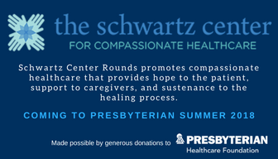
Example of thanking: Presbyterian Hospital
Presbyterian Hospital – Albuquerque, NM
New SC Member
The allocation committee of the hospital’s foundation chose to direct a portion of unrestricted donations to support the implementation of the program.
Notes:
I’d like to share this recent example from one of our newest members, Presbyterian Hospital in Albuquerque, NM.
The medical education coordinator there applied to the hospital’s foundation for funds to cover their initiation and membership fee, and the foundation chose to direct a portion of unrestricted donations to support the implementation of SC membership.
The image you see here is one she created to include in her email signature—both to advertise the SC Rounds, and to thank the Presbyterian Healthcare Foundation for making it possible. It’s a great example of what I just mentioned in terms of thanking donors in the publicity for the sessions.
And, as one more idea for a place to seek funding, if you are a larger organization with an attached foundation, you may want to look into whether that could be a potential source of funds for SC membership.

Slide 13
5. Discussing the costs of membership
Unique fundraising perspective:
Sometimes BIGGER is indeed BETTER
In fundraising, usually the bigger the number, the better our chances of raising big dollars
Think about all related costs
Membership/initiation fee
Food for the attendees (# attendees x $8 pp x # sessions)
Room fees?
A/V expenses?
Staff time, if appropriate – for coordinator, physician lead, facilitator, planning committee members
Notes:
Let’s move now to working with your f/r partner to determine the true cost of SC membership. How do you begin to discuss this and what does an ask look like?
There are a number of different ways to approach this, but let me start by sharing with you something that might seem odd, and it’s probably unique to f/r: Sometimes bigger is better
Usually, the bigger the number, the better a fundraiser’s chance of raising those dollars
Might seem confusing, but the reality is that donors are looking to have impact – a $5k or $50k donation may feel more impactful and better to a donor than a $500 donation, and thus they are willing to donate more or even make a “stretch” gift
Psychology around us fundraisers helping donors express their passion, their caring for this particular subject, and do it in a philanthropic, financial way
So, put together a broad brush budget that includes all relevant costs – your fundraisers will thank you
(Talk through direct costs)

Slide 14
Examples from other members
Sponsorships can range from $5,000-$15,000
Yale-New Haven
Physician leader reached out to development department
Talked to existing donor who happened to know Ken Schwartz
Solicited $10,000 annual sponsorship to cover costs of membership fee and food
Requested a 10-year pledge
Notes:
Let’s give some examples from other sites.
I have seen annual sponsorships range from $5k-$15k – some of that depends on the size of the community that attends your Rounds program; some depends on whether you’re a new member seeking funding for the first year initiation fee, or an existing member seeking support for the annual SC membership fee. Your f/r colleague will help you with this.
Yale-New Haven example – a unique example. Our founder, Kenneth Schwartz, attended Yale, and one of the founders of the SC back in 1995 was at Yale and was Ken’s oncologist.
Unusual circumstance, yes, but no matter where you are located, there is something about the SC’s mission and work that will resonate with someone.
They put together a budget for annual sponsorship and came up with $10k, but this donor had the ability to do a lot more than that. So they requested a 10-year-pledge, to ensure that the Schwartz Rounds/membership was there to stay.
Huge win for the Rounds planning committee who could rely on that money; huge win for fundraiser, who raised $100k; and huge win for the donor, who felt great about what he was doing.
Now I’d like to turn it over to our guest speaker Louisa Nedkov. Louisa is the manager of the Kailo Employee Wellness program at Halton Healthcare in Ontario, Canada, a new SC member. She’s going to tell us a bit about how she went about securing funding for her institution’s Schwartz Center membership. Louisa…

Slide 15
Case study: Louisa Nedkov

Slide 16
Notes:
A brief overview of my role at the hospital/in the system
I am the manager of the Kailo Employee Wellness Program. Unique name for a unique program within a healthcare setting. Kailo is an Indo-European word that means to be uninjured or whole.
We provide support to the staff, physicians and volunteers of three community Hospitals (Oakville, Georgetown & Milton) and 5 off-site locations that provide ancillary services such as Diabetes Care, Mental Health Care, Renal Dialysis, etc.

Slide 17
Innovation Fund
First fund launched 2017
Innovation one of 3 key strategic priorities
2 categories of grants
“Exemplary patient experiences, always”
Notes:
Innovation Fund was first launched at the end of 2017
Innovation is one of the organizations 3 key strategic priorities
Fund provided two categories of grants – small at $2,500 or less; larger with a value of up to $10,000 maximum
The grants are intended to support vision of providing exemplary patient experiences always
Proposal had to align with at least ONE of the five innovative imperatives
I was actually working on a proposal to introduce Aromatherapy into

Slide 18
Hospitalists
Dr. Stephen Chin, Chief of Hospitalists
Wellness Committee for 40 physicians
Schwartz Rounds - Innovation Fund proposal?
Notes:
Dr. Chin approached us about assisting with their newly formed Wellness Committee for Hospitalists
40 doctors that operate out of Oakville Hospital
Dr Chin casually mentioned Schwartz rounds and if I had every heard of the concept – sent me a link shortly following our meeting
Reviewed the website & knew it would help address an important issue in our hospitals

Slide 19
Why Schwartz Rounds?
Clinician burnout/compassion fatigue an issue
1 in 3 healthcare workers affected in Ontario
Burnout is an international epidemic
Providing a forum for staff to discuss/process
Reduces caregiver stress & isolation
Notes:
What about your request resonated with Halton leadership?
We were interested in Schwartz Rounds as it addresses a challenge within healthcare: clinician burnout & compassion fatigue
According to recent research conducted on four Ontario Hospitals, 1 in 3 healthcare workers are affected by burnout and/or compassion fatigue
Clinician burnout is an international epidemic (based upon all my research)
Schwartz rounds provides a safe forum for staff to discuss and process the difficult issues they face in caring for patients and families
This has been proven to reduce caregiver stress and isolation, improve communication and teamwork, and help caregivers better meet their needs

Slide 20
“Exemplary Patient Experiences, Always”
Compassion
Patient Experience
Engaged and resilient healthcare staff
Notes:
A core value of Halton Healthcare is compassion
Caregiver experience drives patient experience
Building engaged and resilient healthcare staff will enable our organization to provide the most compassionate, patient-centered care possible
Turn over to Lisa.

Slide 21
For further information or advice, please feel free to contact Lisa M. Crane
at 617-643-5490 or lmcrane@theschwartzcenter.org
theschwartzcenter.org

Slide 22
Questions & Answers
Lisa M. Crane
Director of Individual and Foundation Giving
The Schwartz Center for
Compassionate Healthcare
Louisa Nedkov
Manager. Kailo Employee Wellness Program
Oakville Trafalgar Memorial Hospital
Halton Healthcare
Type your comments and questions in the “Questions” pane on your screen at any time.

Slide 23
Thank you for participating in today’s session.
Please take a moment to complete the
electronic survey upon exiting the webinar.
Visit theschwartzcenter.org to learn more about our programs or register for a future webinar.
Look for our webinar invitations and feel free to share them with colleagues.

